Slide 1
Lec 06: Technology Progression and Transformation of Human Role (future of work)
EEE 452: Engineering Economics and Management
M. Rokonuzzaman, PhD
Zaman.rokon.bd@gmail.com
www.the-waves.org
©️Rokonuzzaman
--use is permitted only for the purpose of EEE 452 (sections 1,2,3, 4 & 6 offered at NSU in Fall 2022);no consumption and distribution is allowed for any other purpose

Slide 2
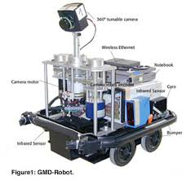
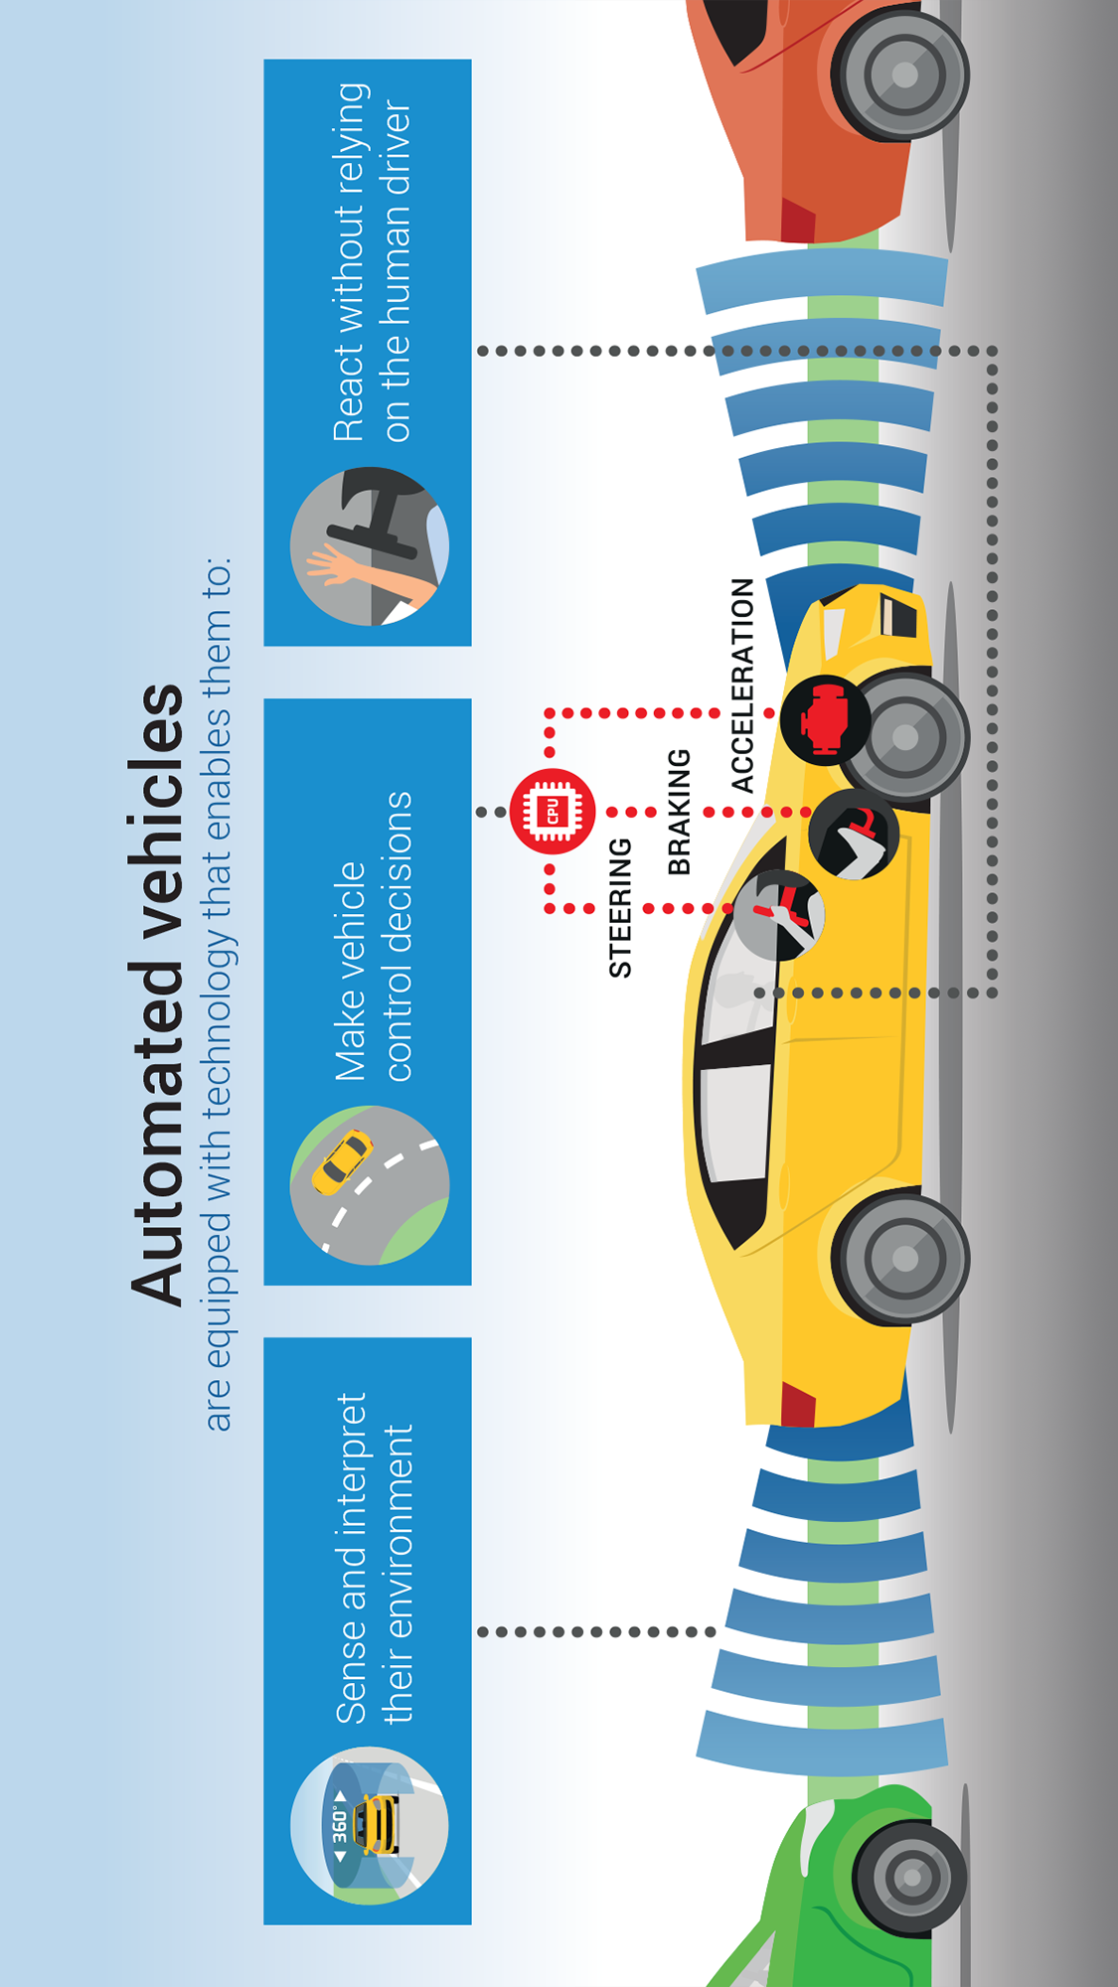
Role of Human in Production and Innovation
Production focuses on replication—keep processing inputs as per given recipe or ideas (A)
Y=F(K, L, H)
These three factors are not independent. They can mutually affect each other. For example, automation increases the role of K. But growth in K reduces the demand for L and H—in replication. By the way, we need A for advancing automation. Furthermore, automation can also increase the demand for L, too. Besides, the degree of difficulty in automating L and H is not same.
Hence, there has been need for looking into the underlying dynamics due to the technology advancement for interpreting the varying role for A, H, L, and K in production.
For changing the recipe, we need invention, reinvention and innovation. For it, we need ideas, A:
Ideas, A=F(Knowledge, Creativity), we need H for knowledge and creativity.
Although the role of labor in production has been falling, there is an exponential growth of human capital or R&D effort for producing profitable revenue from innovation. Apparently, ideas are easy to get. But the challenge is in turning them into profitable alternative.
For example, autonomous vehicle idea is very easy. For decades, students have been demonstrating autonomous mobile robots roaming in hallways. But scale up of this idea for autonomous vehicle has so far consumed more than $80 billion R&D funding without reaching the target of rolling out of such vehicles.

Slide 3
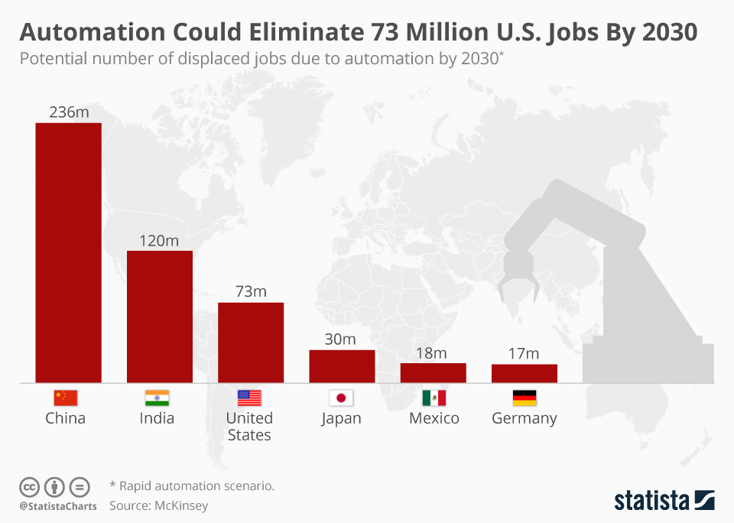
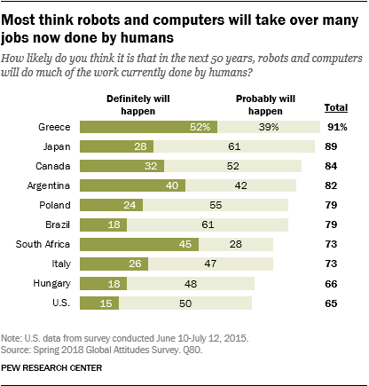
Job Loss Claims due to Robotics and Automation
There have been growing job loss claims due to robotics and automation. But is it new? Or, is it always harmful?
It’s neither new nor harmful. Does automation always create job loss? Not yes, either.
Any productive activity begins in art form—requiring significant knowledge, ideas, and experience. To scale it up, that art form of productive activity is being transformed as a series of tasks, which are being performed in a certain sequence following certain rules. Tools are being developed to automate the application of rules, knowledge, and skills.
As a result, knowledge and skill requirements in performing each task falls—opening the door of making unskilled labor force eligible to participate in production. Consequentially, jobs for low skilled work force is created. But it happens due to the automation of knowledge and skill of highly knowledgeable and skilled artisans or workforce. It also creates the jobs for R&D in codifying knowledge and skills and developing machine and process capability to automate them.
Hence, automation underpins job creation. We call some of those automated tools robots. Besides, automation and robotics take over dangerous jobs, and perform operation with higher level accuracy and efficiency than human workers can deliver.
https://www.the-waves.org/2022/01/07/disruptive-innovation/

Slide 4
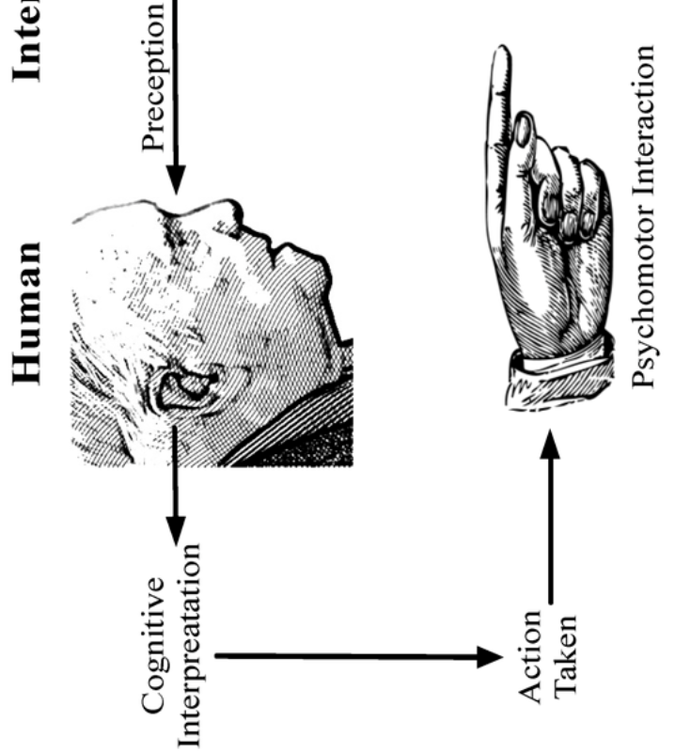
Roles and Capabilities of Human
There have been human roles in three distinct phases: i Invention, Reinvention and Innovation, ii. Replication or production of products, and iii. Consumption of products for extracting utility in getting jobs done.
Human beings bring three distinct capabilities in playing those roles: i. Innate abilities, ii. Codified knowledge and skill, and iii. Experience earned tacit knowledge and skills.
In performing roles, human beings acquire the eligibility through three major means: (i) Innate abilities as a by born capability, (ii). Tacit capability earned through experience, and (iii) Codified knowledge and skill acquired through education and training.
By born, human beings have vital innate abilities. They are broadly segmented into four categories: i. Cognitive (21 elements), ii. Physical (9 elements), iii. Psychomotor (10 elements), and iv. Sensory (12 elements). Each of the categories has multiple sub-elements. In total, human beings have 52 innate abilities. These abilities are vital in all phases of product life cycle—invention, replication, and usages.
Through scientific investigation, human beings have been discovering knowledge. That knowledge is used to invent technologies and design skills in machines in performing tasks. The scientific knowledge, technology inventions, and skills are being codified forming codified knowledge and skill base. We acquire them by attending schools, colleges and universities. As a result, our eligibility in performing tasks grows through education and training.
Furthermore, we acquire and fine tune knowledge and skill through experience. This forms in tacit form--implicit knowledge and skill or implied without being stated.
Invention, Reinvention and Innovation
Replication of products
Usages of products
Innate abilities
Tacit capability
Codified knowledge and skill

Slide 5
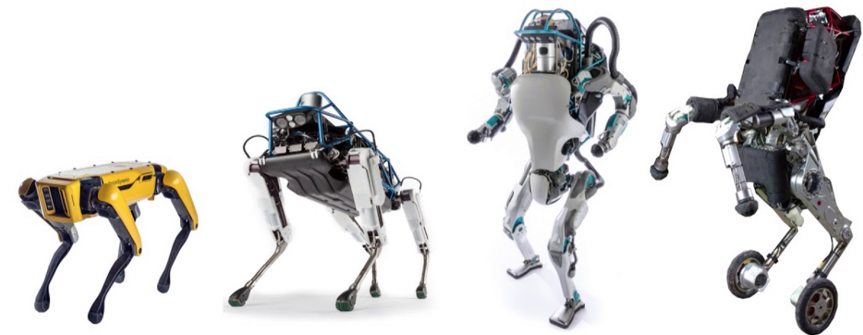

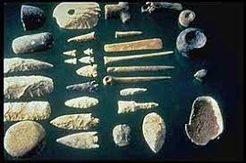
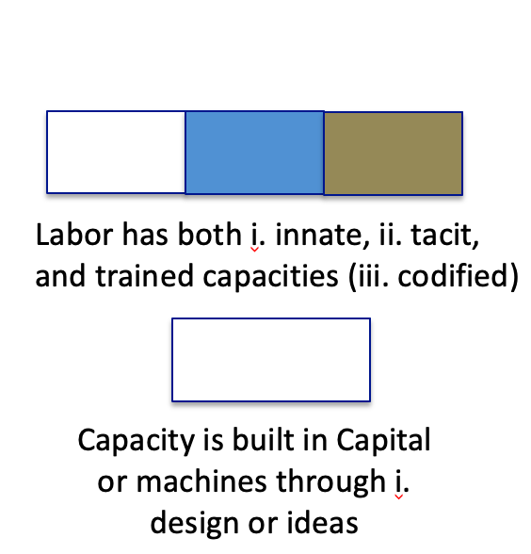
Machines—evolving capabilities
Machines are built with inanimate materials, which are devoid of task execution capacity (often termed as lack of knowledge and skill about task) to begin with. The technology advancement is being leveraged to build task execution capacity in machines through design.
At the beginning, we succeeded to imitate human beings’ physical capabilities in machines. For example, we developed machines to replace the role of our fingers to manipulate materials like soil. We moved further to develop machine to replace the role of human or animal in supplying energy in productive activities.
Till 1900, machines were being developed to imitate coarse manipulation and energy providing role. By 1950, we succeeded to develop creating logical capabilities in machines, mostly through mechanical means.
Since, 1950s, we have been progressing in adding sensors to machines. Most importantly, we have been adding computational and data storage capability in machines. As a result, machines are succeeding to automate many of our codified capabilities. Furthermore, we have been attempting to develop human like cognitive perception, decision making and action taking capabilities in machines.
Hence, we have been succeeding in keep adding task execution abilities in machines.

Slide 6
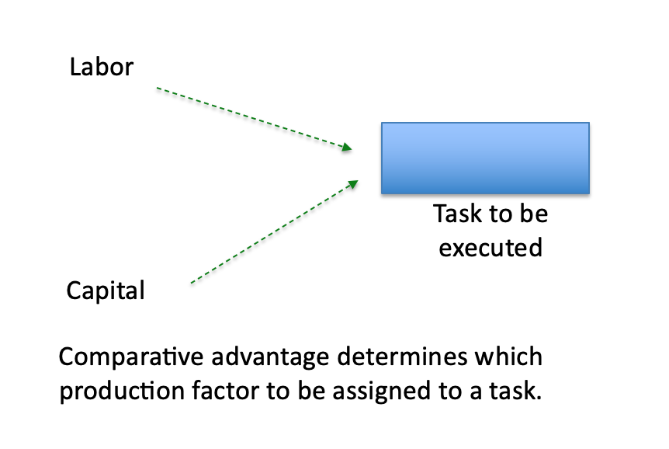
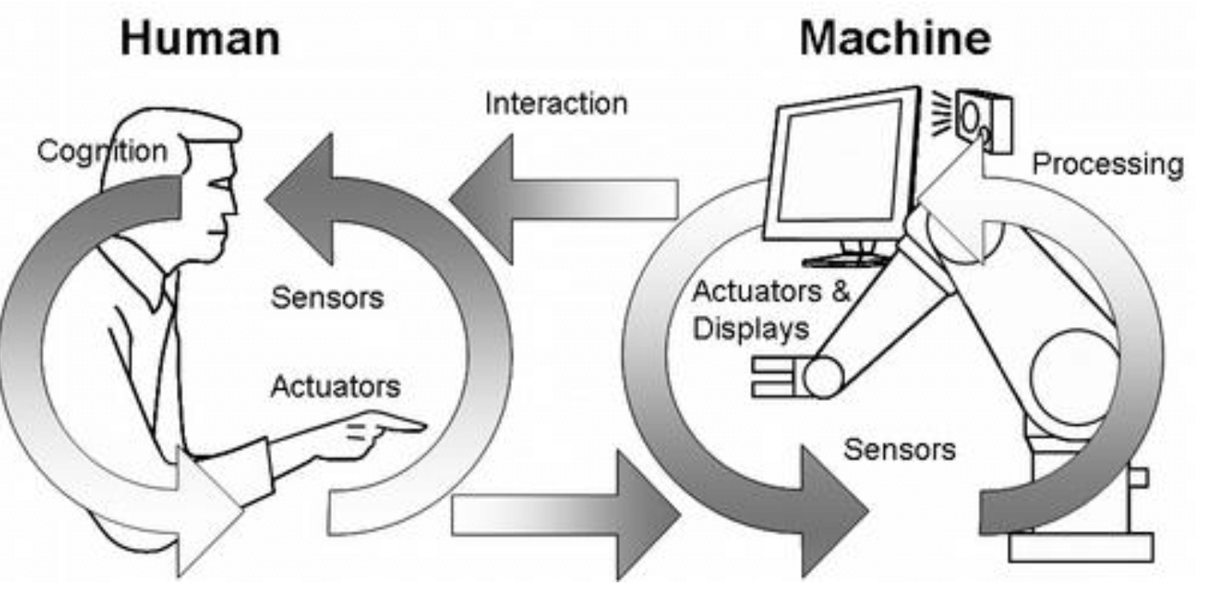
Tasks Execution Capabilities and Means to Earn Them
A task execution complexity demands capacity of production factors. Execution complexity depends on the need of capacity in the form of (i) knowledge, (ii) manipulation, (iii) movement, (iv) communication, and so on.
We have two actors in performing tasks: i. Human (labor) and ii. Machine (capital)
Production factors acquire those capacities through three primary means: (i) innate ability, (ii) education and training and (iii) design.
Whom to assign to get a task executed? It depends on the comparative advantage.
The technology advancement is being leveraged to build task execution capacity in machines through design.
Based on comparative advantage, production factors whether labor or machine (often called capital) is assigned to a particular task.
Due to the growth of machine capability, there has been on-going transformation of task allocation between human and machine.

Slide 7
Sharing the Production Work: Human and Machine
In production, two factors such as labor and capital (machinery) share roles in performing tasks in producing outputs as shown below:
Q = f(K, L)
Here Q: Output, K: Capital, and L: Labor
In order to meet the growing wage of labor, and offering better quality output at lower cost, profit-maximizing firms have been improving the role of capital or machinery. Technology is being developed to build machines, better machines to delegate increasing role from labor. As a result, comparative advantage between capital and labor has been continuously shifting towards machine as shown.
To produce same outputs, role of labor is being replaced with the growing role of machine
Capital or Machinery
Human or labor

Slide 8
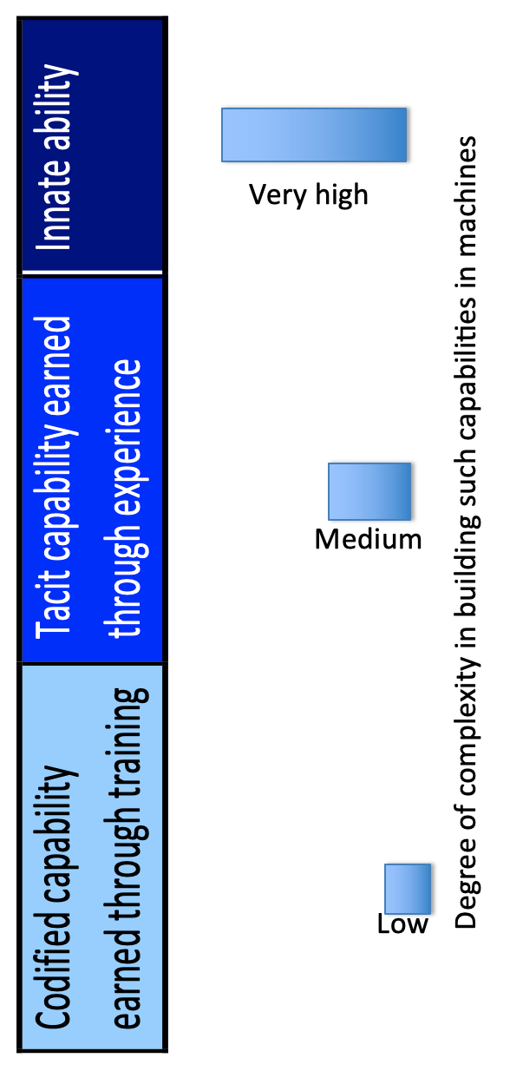
Degree of Complexity in Building Machine Capability
It has been found that building machine capability to imitate human beings’ coarse physical abilities like manipulation and providing energy is quite easy. But imitating high-precision and flexible manipulation is quite complex. For example, despite significant effort over the last 300 years, our success in developing human like machine hand has been far beyond our reach.
It has been observed that innate ability of labor, like vision, touch, perception, natural language as well as gesture based communication, is a highly complex capacity. It’s very expensive, perhaps not impossible, to build such capacity in machine.
On the other hand, the codified capacity which human workers or labor earn through training is far less complex to build in machines through design. For example, we spend years to learn complex mathematical relations to solve equations of kinematics and dynamics. But it does not take much effort to write code and develop software to develop similar abilities in machines.
In fact, hard earned experience earned tacit capability is also amenable to codification and automation.
The most complex part is to imitate human like perception abilities in machines. For example, although sensors have been producing high-resolution images, developing human like perception capability for analyzing those data is quite premature.

Slide 9
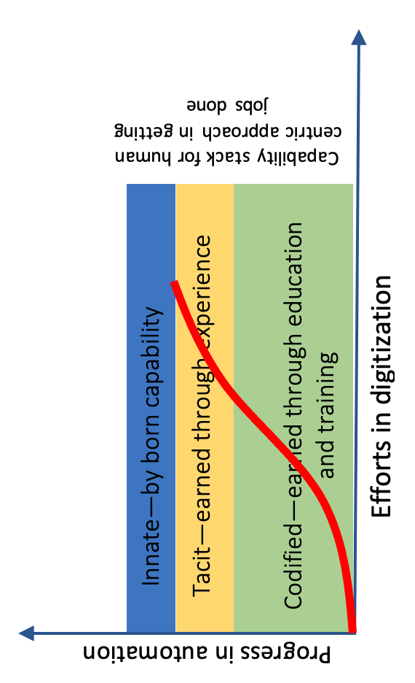
Elusive pattens in digitisation--after ramping up, progress slows down and saturates before reaching the target
Digitisation is a buzzword of automation. There has been a hype in automating diverse tasks with digital technologies. Some of them are autonomous driving, prescribing medications, checking health status, and offering education.
But many of those jobs require a combination of codified, tacit and innate abilities. Upon showing rapid progression in automating codified aspect, the progress of digitisation slows down in automating our tacit and innate abilities. Moreover, it stops progressing before reaching the target--due to insurmountable barrier it counters to imitate human like innate abilities in machines (both software and cyber-physical systems).
As a result, many high-flying digitisation projects are partially cooked. For examples, upon spending $80 billion in R&D, autonomous vehicle innovators appear to be stuck. Similarly, upon investing $4 billion in automating medical prescriptions with Watson, IBM encountered insurmountable barrier to automate common sense of physicians. Without being much aware of it, some people are after accepting on-line education as an acceptable substitute to campus based education.
It's time to look into underlying patterns in scoping out digitisation aspiration.

Slide 10
Job Polarization-–at the organization level
It appears that at the bottom layer in firm, tasks require high-level innate (I) ability of human workers, and a small portion of codified (C) capacity.
At the middle, the necessity is being reversed. At the top, both of them are equally required as shown.
Information and communication technology (ICT) has been offering increasing scope in building codified capacities like crunching numbers, solving mathematical equations, visualizing data or discerning information from data, which human beings earns through education and training, in machines.
As a result, lower level tasks requiring mostly innate ability are being performed by low skilled labor.
On the other hand, tasks, which are being performed by highly trained middle layer professionals, are being increasingly delegated to machines.
Such reality is causing job polarization effect—hollowing out the middle, while having very little effect at labor-intensive bottom layer.
I
I
C
C
C
I
Organizational Pyramid
Lower Middle Top

Slide 11
Decreasing Training Need for Low Skilled Tasks
Capacity of workers performing tasks could be divided in three components: (i) innate ability, (i) tacit knowledge and skill earned through experience, and (iii) codified capability earned through training.
Continued technology progression has been supporting the building capability in machines in taking over codified as well as tacit capability of human workers.
As a result, in one hand training demand for low skilled workers has been falling. On the other hand, variability of skill requirement has been also decreasing, leading to decreasing inequality in pay at the bottom.
But many famous organizations have been asking for more training need.
By the way, the episode of reinvention around a new technology core demands change of skill for production and operation.

Slide 12
How does job originate and disappear?
Technology supports innovation of new products. In producing those products, tasks needs to be executed in producing each feature (component) and assembling them together.
Availability of jobs depends on:
A set of products to be produced:
p₁,…p_{L}
A set of features to be added in making each product:
f₁…f_{M}
A set of tasks to be executed to make each feature:
task₁,..,task_{N}
A firm as well as an industry, also country as a whole, at a certain point in time is producing a set of products P, consisting of N number of products.
Each product p∈P has a set of F, comprising of M number of features. In order to add each feature to a product, a set of tasks T should be executed.
Based on the comparative advantage, production factors whether labor or machine (capital) are assigned to a particular task in adding features to produce products.
The labor requirement in a firm, industry or a country depends on product set, volume of production, and comparative advantage of labor and capital.

Slide 13
Technology increases the task supply
Technology not only empowers the designer of better machine capability in allowing taking over increasing role from labor.
Technology also opens the opportunity of developing new products as well as adding new feature to existing products.
As a result, demand for labor also increases for producing additional products as well as features.
For example, many of the industrial products what we use today were not in existence 100 years ago.
Introduction of new products
Creating new tasks, and generating new demand for labor
Technology
progression
Introduction of new features to existing products
Figure : Effect of technology progression on creating new demand for labor

Slide 14
Fourth Industrial Revolution
The technology stack driving the fourth industrial revolution has been opening the opportunity of building innate capacity like vision in machines. It appears that progress in building innate capacity in machine will lead to delegation of tasks being performed by low skilled labor, primarily relying on innate ability, will be taken over by capital or machine as well.
For example, aggressive R&D and startup activities are underway to develop autonomous vehicle.
The purpose of such endeavor has been in building tacit as well as innate ability of human drivers into machines.
It appears that such trend will continue in building human workers’ innate ability into machine, making capital as a better choice than labor in performing bottom layer tasks of the manufacturing value chain, which are currently being performed by labor in developing countries.
The technology stack driving the fourth industrial revolution has been opening the opportunity of building innate capacity like vision in machines. It appears that progress in building innate capacity in machine will lead to delegation of tasks being performed by low skilled labor, primarily relying on innate ability, will be taken over by capital or machine as well.
For example, aggressive R&D and startup activities are underway to develop autonomous vehicle.
The purpose of such endeavor has been in building tacit as well as innate ability of human drivers into machines.
It appears that such trend will continue in building human workers’ innate ability into machine, making capital as a better choice than labor in performing bottom layer tasks of the manufacturing value chain, which are currently being performed by labor in developing countries.

Slide 15
Country Level Job Polarization Effect
Advanced countries suffered from technology influenced job loss for two major reasons. The first one is that ICT empowered the transfer of the codified capability of middle layer professionals to machines. On the other had, job division facilitated the transfer of earned capability of labor performing lower level tasks were transferred to machines.
As a result, lower level tasks started demanding decreasing amount of trained skill and experienced earned tacit knowledge or capacity. The second effect created the window of getting those lowest level manufacturing jobs done by low skilled workers of developing countries.
Producers took the advantage of it by offshoring those tasks to low skilled labor. As a result, advanced countries lost manufacturing jobs; consequentially, developing countries gained jobs, particularly in the manufacturing value chain, and also in service value chain.

Slide 16
But technology progression, particularly ICT, also fueled the journey of introducing new products and also adding new features to existing products. Advanced countries benefited from it, as it created high paying innovation jobs. On the other hand, due to very weak R&D capacity and poor industrial capability, developing countries could not benefit from technology progression in creating high paying innovation jobs.
In contrary to the third industrial revolution, the fourth industrial revolution has been providing technology for building machine capabilities to take over human innate capability intensive jobs. Such transformation is creating high paying machine design innovation jobs in advanced countries. On the other hand, developing countries will be suffering from manufacturing job loss by importing those capital machineries. As a result, in the age of fourth industrial revolution, advanced countries will experience employment gain, causing job loss in developing countries.

Slide 17
Challenges for developing countries
Technologies have been creating as well as declining demand for labor and raw material. For example, gasoline engine technology created the demand for liquid fuel. The progression of electric vehicles to be charged by renewable energy sources like solar cell or wind turbines will likely be reducing the demand of petroleum.
Similarly, the progression of technology like ICT, and job division led to the building capability of machine in attaining codified as well as tacit capability, which human workers or labor earn through training and experience. As a result, over the last several decades, tasks at the middle layer have been increasingly being delegated to machine.
On the other hand, training need to acquire codified capability in performing low level tasks have been decreasing, opening the opportunity of low skilled workers equipped with just innate capabilities in taking over those jobs. So far labor as well as natural resource like petroleum products have been benefiting from this transformation. But situation will start likely change, as electric vehicle starting taking over gasoline ones and smart machines start attaining humans’ innate capabilities like vision.
They need to take advantage of 4IR (fourth industrial revolution) to innovate to introduce new products, and also features of existing products.

Slide 18
Sharpen and Augment Innate Capability
For example, doctors cannot travel through different organs, and fish farmers cannot look though the water to understand the health of fish. Similarly, dairy farmers cannot understand state of mind or body of cows well.
Technology stack of the forth industrial revolution can support us to innovate to augment human’s innate capability to make them play far more important role than before in performing production jobs.
We can also sharpen innate abilities through training. Sharpening of innate abilities will lead to productivity improvement and also the reduction of progression of automation in taking over jobs.
Even creative innate ability could also be sharpened.

Slide 19
Effect of Innovation on Tasks and Human Capital Demand
Y=F(A,X)
There are three major innovation types, having varying effect on tasks. These innovation types are: 1. Sustaining (incremental) innovation, 2. Process innovation, and 3. Disruptive innovation.
Sustaining innovation focuses on addition of new features as well as advancement of existing features. Addition of new features invariably introduces new tasks.
But advancement of existing features has mixed effect; depending on the feature and nature of advancement, it may kill or add tasks. Process innovation invariably focuses on increasingly advancing machines’ comparative advantage over labor in performing tasks.
Disruptive innovation has mixed effect. It introduces new products, consequentially new tasks to make them. But it also destroys the demand of existing products, reducing the demand of tasks in making them. Invariably, disruptive innovation expands the market, expanding the volume of production.
R&D effort for unit of output
Time
Human capital demand for producing each unit (say, $1 million) of economic value out of ideas has been exponentially growing
“Research productivity in the U.S. has fallen 5.3% per year on average, according to our estimates. In order to offset the increased difﬁculty of ﬁnding new ideas, the level of research looking for new ideas must be doubled in the United States every 13 years, just to sustain constant GDP growth per person — and that’s a tall order”

Slide 20
Effect of product redesign on tasks and labor demand: Often product redesign leads to eliminating tasks in making products, and task simplification, so that machines can have comparative advantage.
Effect of competition and monopoly of innovation and task creation: Competition has mixed effect on task supply. In one hand, competition adds features to product and pursues disruptive innovation. On the other hand, competition also encourages product redesign and process innovation in eliminating tasks as well as delegating tasks to machines.
Effect of export led manufacturing on task introduction: Export oriented manufacturing often creates the demand of low skilled tasks in developing countries. To organize and support low skilled tasks, some managerial and support tasks are also created.
Effect of import substitution on task introduction: Import substitution creates tasks for local production.

